Slide 1

Consumer Behaviour Submitted by : PGP DSE GGN Jan’21-Aug’21 Mentor : Capstone Group 3 Vibha Santhanam

Slide 2

TABLE OF CONTENTS
S.No | Topic | Slide No.
1. | Industry Review | 3
2. | Business Problem | 4
3. | Datasets and Domain | 5
4. | Variable Categorisation | 7
5. | Missing Values | 9
6. | Project Justification | 10
7. | EDA | 11
8. | RFM Analysis | 13
9. | Observations | 16
10. | Rating Prediction | 20
11. | Plots | 23
12. | Market Basket Analysis | 28
13. | Scope | 31
14. | References | 32

Slide 3

Industry Review
Businesses have always tried to keep their customer base engaged and satisfied with the services provided by them. To remain relevant in the industry, they need to incorporate the latest technological advances into their services.
More than a decade back, it was the internet which was completely new and various industries tried to leverage the capabilities of this technology that effortlessly acted as a medium of communication between various businesses and their customers.
In this decade, industries have started to provide services that are catered towards each client’s individual needs. For such services, they are required to leverage the power of artificial intelligence.
Comprehending the reviews of customers is very crucial for a business to be successful. Analyzing the reviews helps to properly discern the customer different preferences, likes, dislikes, etc. These extracted insights can then be used to improve customer service and experience.

Slide 4

Business Problem:
The brazilian customers are more conservative about their spending nature. We wanted to look at this scenario in terms of understanding their needs and requirements to make their as well as retailers life easier.
They tend to have more reservations when buying goods online that aren’t essential. So, we need to suggest appropriate promotions by the businesses so we can attract more and more customers.
Pricing become less of a sore point once consumers know that they like what they will get.

Slide 5
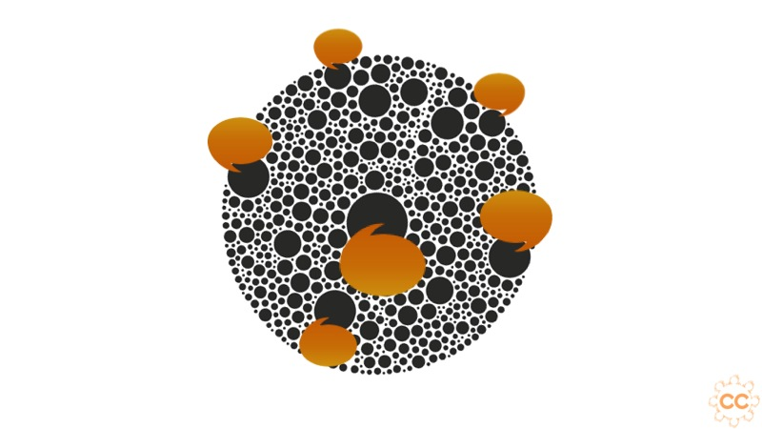
Dataset and Domain:
olist_orders_dataset: This table is connected to 4 other tables. It is used to connect all the details related to an order.
olist_order_items_dataset: It contains the details of an item that had been purchased such as shipping date, price and so on.
olist_order_reviews_dataset: It contains details related to any reviews posted by the customer on a particular product that he had purchased.
olist_products_dataset: It contains related to a product such as the ID, category name and measurements.
olist_order_payments_dataset: The information contained in this table is related to the payment details associated with a particular order.
olist_customers_dataset: Details the customer base information of this firm.
olist_geolocation_dataset: It contains geographical information related to both the sellers and customers.
olist_sellers_dataset: This table contains the information related to all the sellers who have registered with this firm.

Slide 6
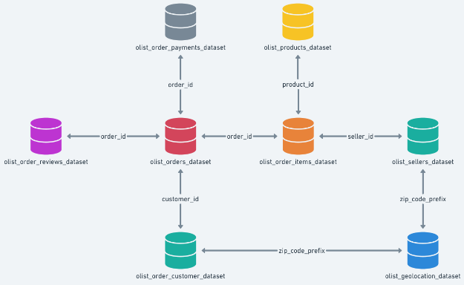

Slide 7
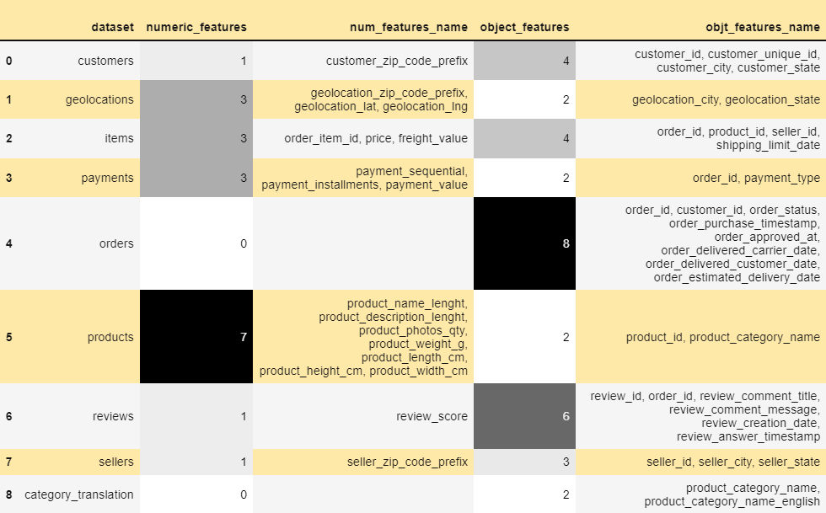
Variable categorization: categorical vs numerical

Slide 8

Observations:
Products dataset has maximum number of numeric features(i.e dtype: 'int16', 'int32', 'int64', 'float16', 'float32', 'float64')
Orders dataset has maximum number of features of object dtype.
We can also observe that all the timestamps are in object data types .So, we have to convert it into datetime type to do analysis on these features.

Slide 9
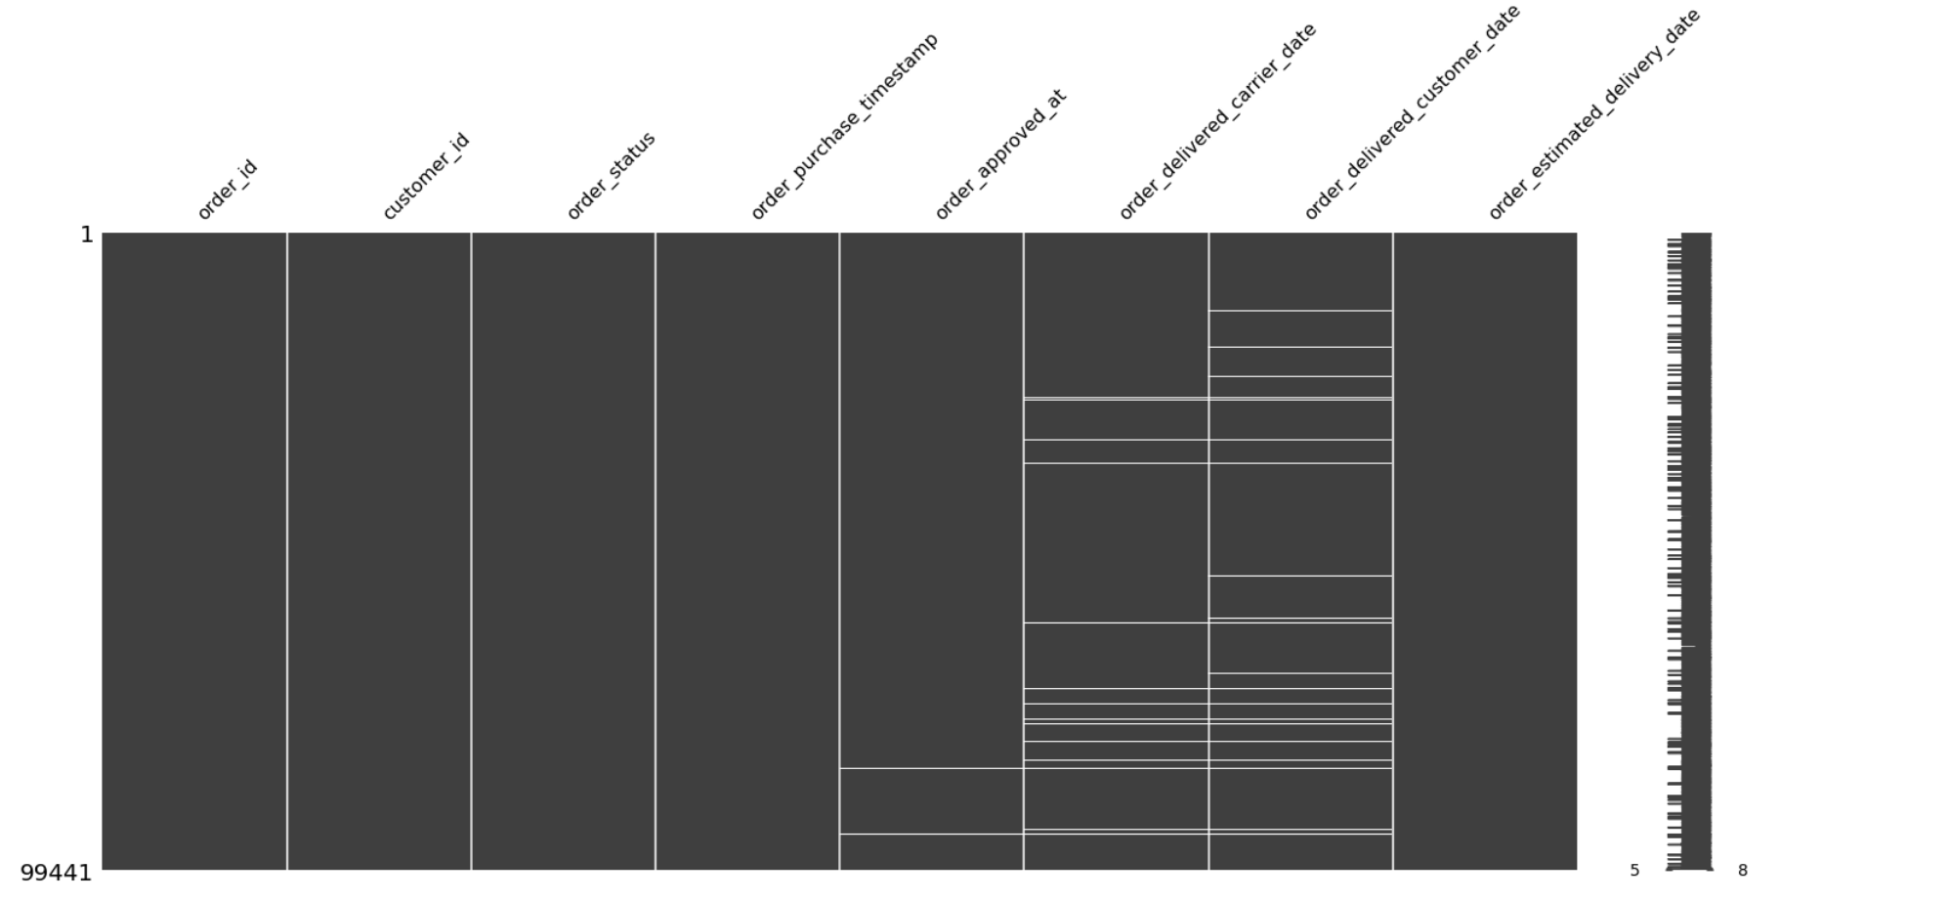
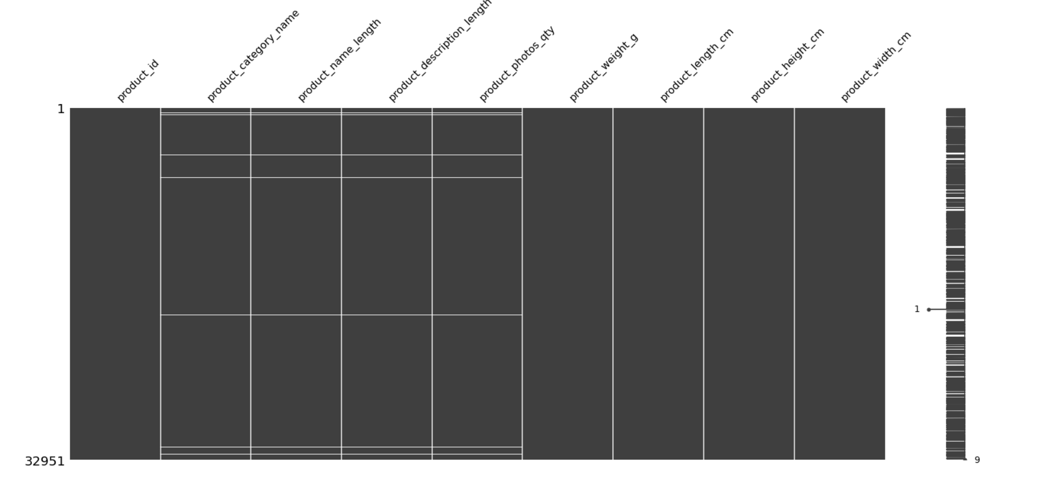
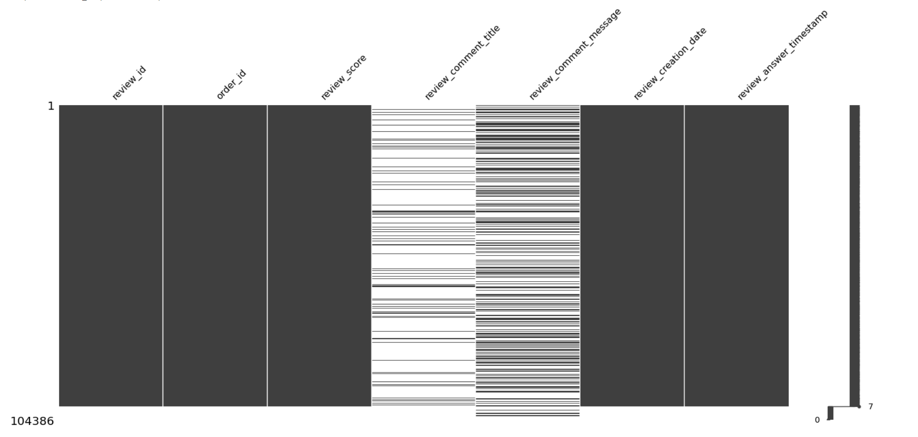
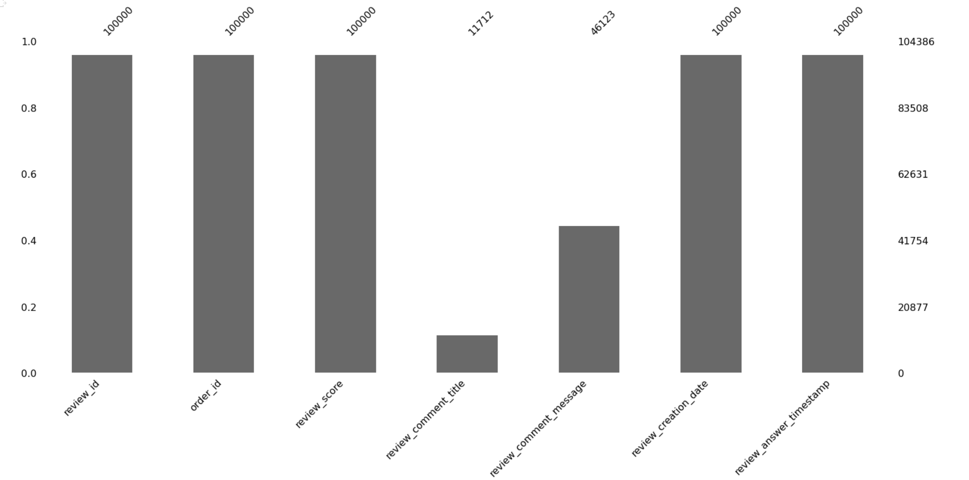
Missing values
olist_products_datas
olist_orders_dataset
olist_products_dataset
olist_orders_reviews_dataset

Slide 10

Project Justification:
Problem statement:
To understand the product placement as per the consumer needs that would help the retailers understand the consumer demands.
Project Outcome:
We have calculated customer scores based on customer segmentation using RFM analysis (recency, frequency, monetary values) for the retailers.
Then, we can implemented the churn analysis, that will help us to target the customers that are not satisfied with our services. Hence, we can also implement right marketing strategies for retaining them.
Next, we implemented market basket analysis to know the requirements or tastes of the customer, in order to make a personalised shopping experience for them.

Slide 11
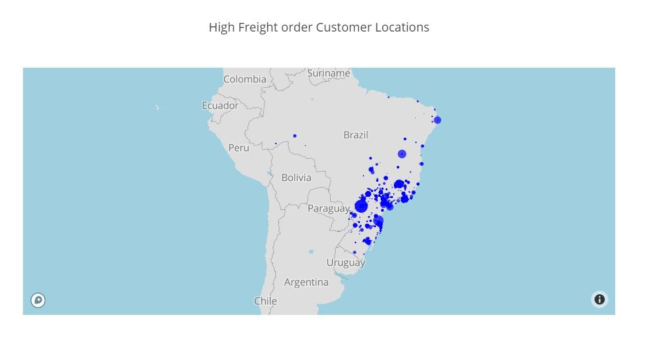
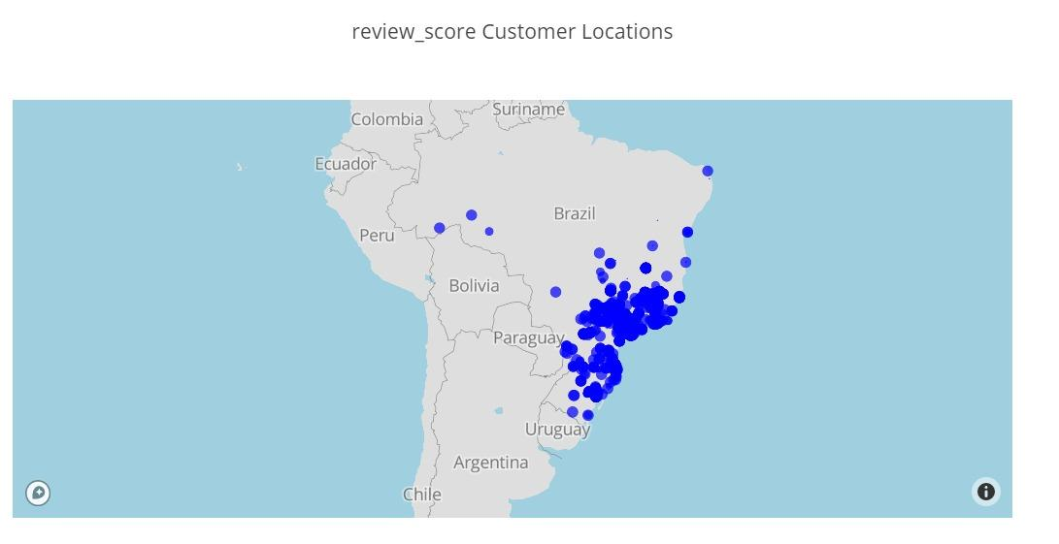
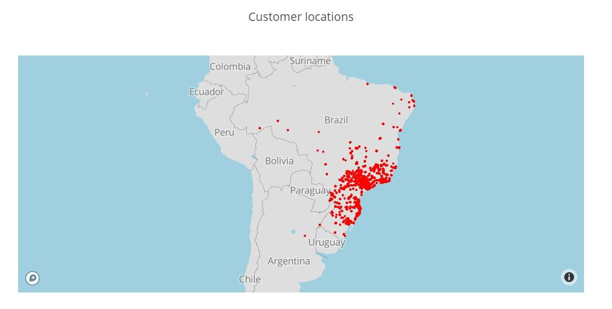
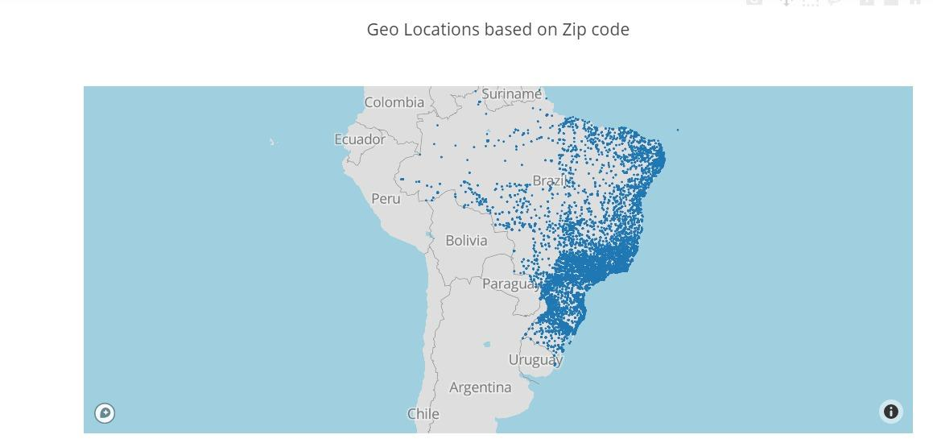
Data Exploration (EDA):
Univariate analysis:

Slide 12
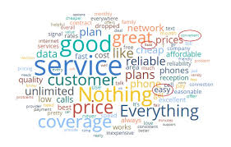
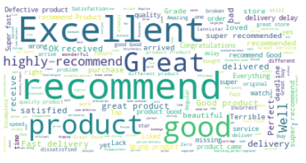
Word Cloud :
Initially the language of the review was translated from Portuguese to English. Then all the null values were dropped. Finally, word cloud was created which shows the words in order of their frequency. The word with highest frequency is shown bigger as compared to the word with the lowest frequency shown smaller.

Slide 13
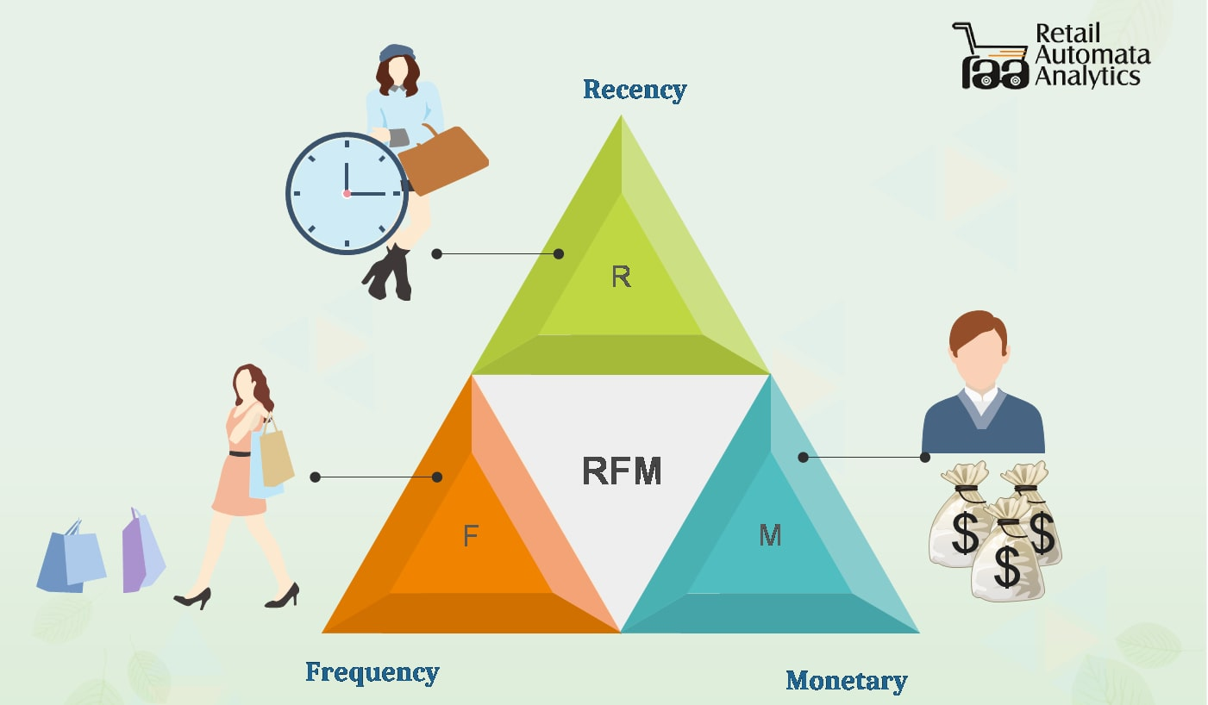
RFM –Analysis
What is RFM?
Direct marketing is the control of customer acquisition and contact. It is important to quantify customer behaviour so that the short and long-term effect of segmentation formulae can be tested. RFM provides a simple framework for quantifying that customer behaviour. Once customers are assigned RFM behaviour scores, they can be grouped into segments and their subsequent profitability analysed. This profitability analysis forms the basis for future customer contact frequency decisions.

Slide 14
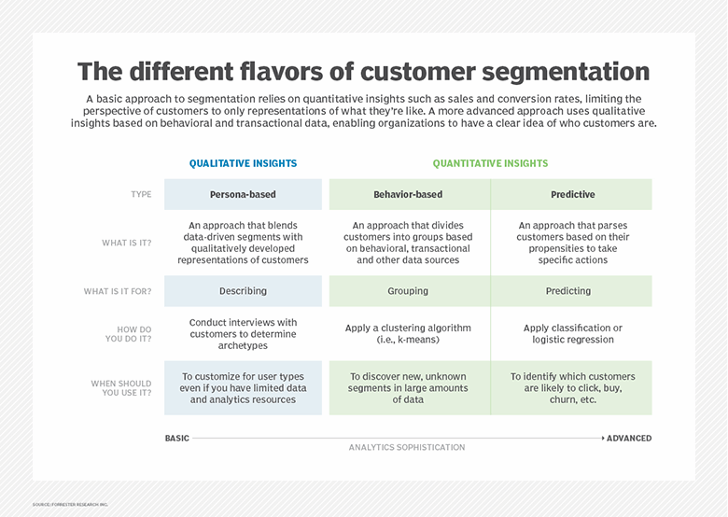

Slide 15
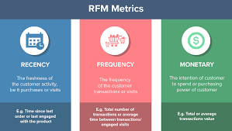
RFM analysis ranks each customer on the following factors:
Recency — number of days since the last purchase
Frequency — number of transactions made over a given period
Monetary — amount spent over a given period of time

Slide 16

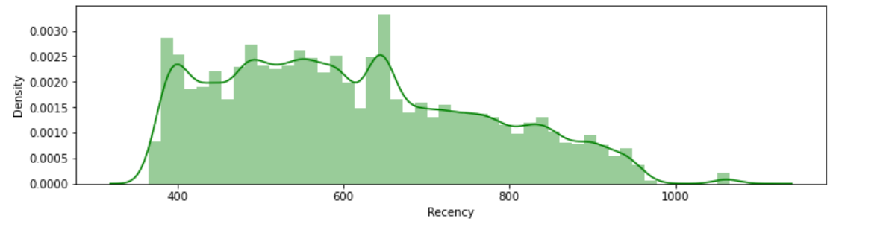
Observations:
There are three density plots of recency, frequency and monetary.
Most of the users stayed with olist for a long duration which is a positive thing but order frequency is less.

Slide 17
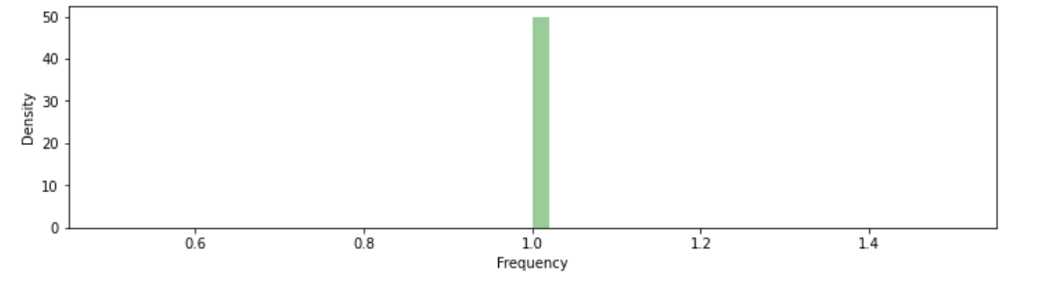
Observations:
B. Frequency of most number of orders is just about over 1

Slide 18
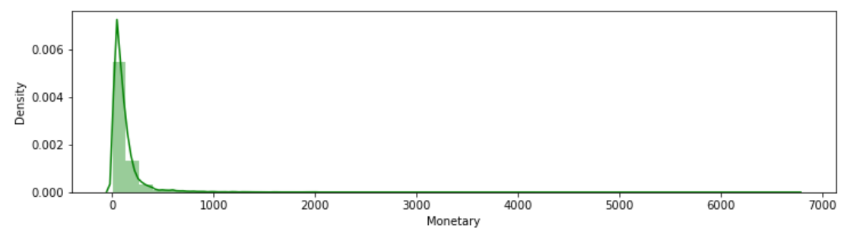
Observations:
C. Maximum amount spent over the given period is less than 900 with a lot of small amount transactions.

Slide 19
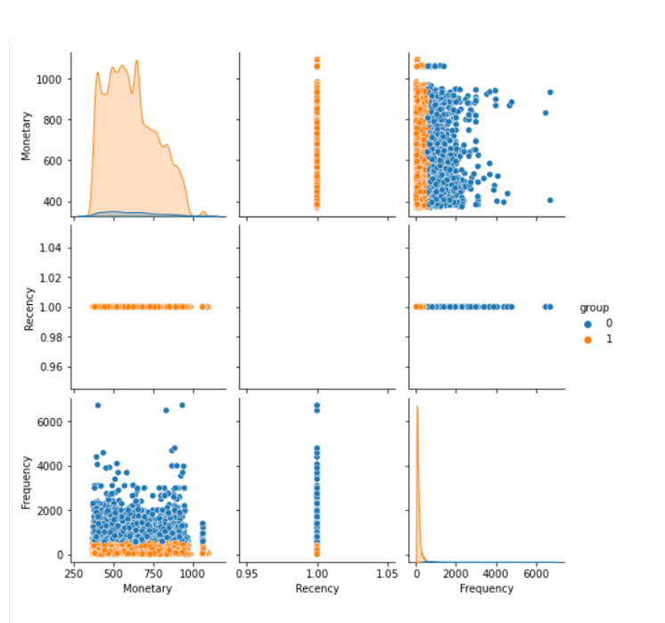
Observations:
D. From Customer segmentation using USL,
it can be seen that customers are divided into
2 groups based on RFM data.

Slide 20
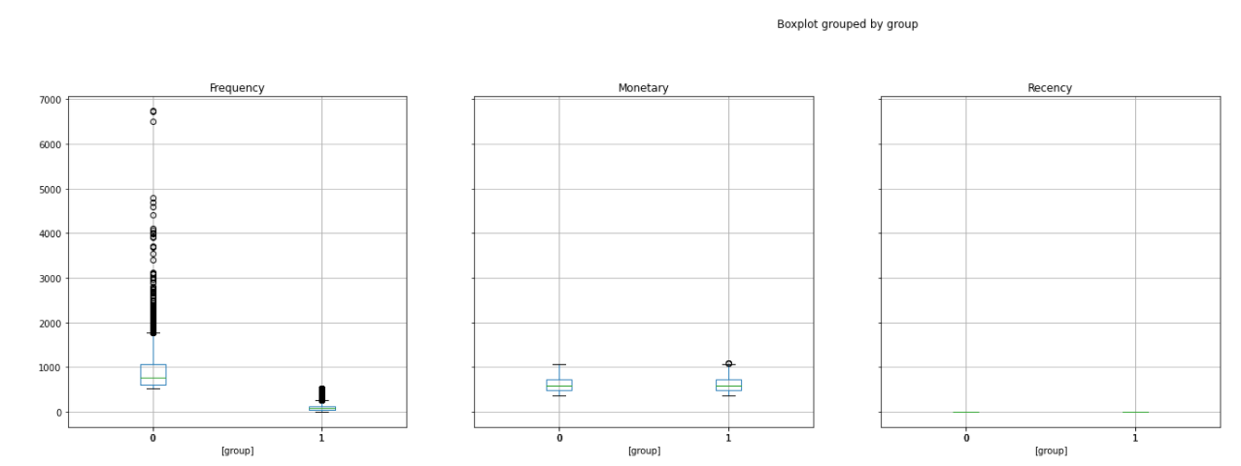
Observations:

Slide 21
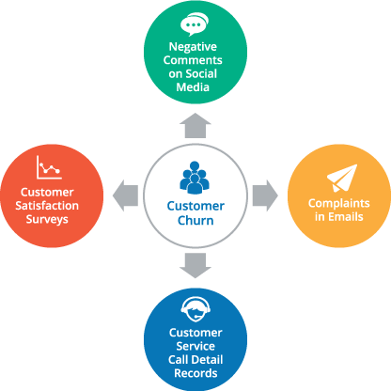
Churn Analysis
Customer churn or customer attrition is the
phenomenon where customers of a
business no longer purchase or interact
with the business.
Customers with low RFM Score are first to
leave and are to be focused on.

Slide 22


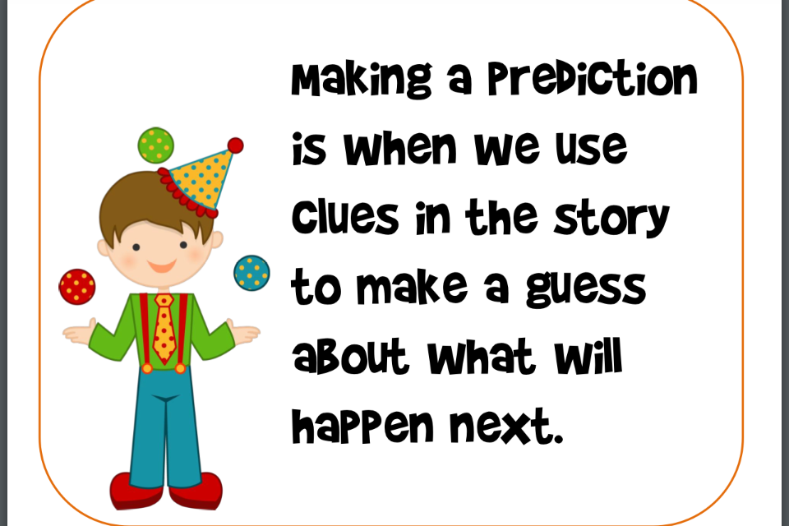
Rating Prediction
The rise in E — commerce, has brought a significant rise in the importance of customer reviews.
70 percent of customers say that they use rating filters to filter out low rated items in their searches.
The ability to successfully decide whether a review for a particular product will be helpful to other customers and thus give the product more exposure is vital to companies.

Slide 23

Possible Factors affecting the Rating for a product delivery:
User review comment
Freight value
Duration to complete the delivery.
Price of the product.
Seller and customer state.

Slide 24
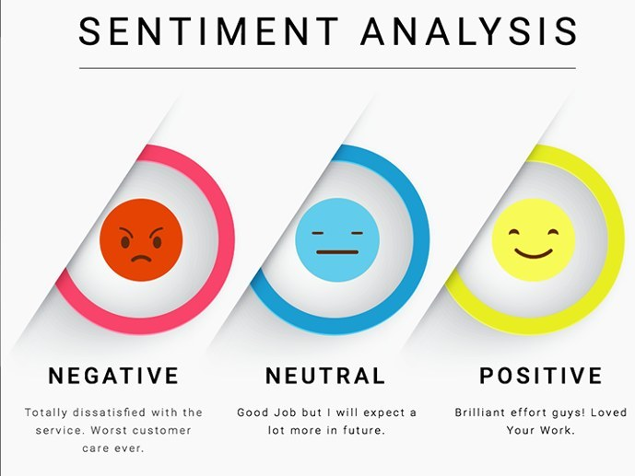
Method used to understand User review comment :
Sentiment analysis is part of the Natural Language Processing (NLP) techniques that consists in extracting emotions related to some raw texts.
This is usually used on customer reviews comments in order to automatically understand if some users are positive, negative or neutral and why.

Slide 25
We have performed modelling using the possible variables, starting with Decision Tree as our base model.
MODEL OVERALL ACCURACY
Decision Tree 67.36%
Tuned Decision Tree 67.24%
Random Forest 78.28%
Tuned Random Forest 80%
Since, overall accuracy of 80% is achieved by Tuned Random Forest,
Thus, product rating can be predicted well by the model.

Slide 26
Some plots and observations :
Main Features affecting the review score:
Duration to complete the delivery.
Freight value
User review comment
Price of the product.
Seller and customer state.

Slide 27
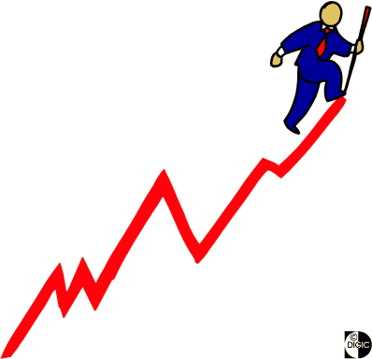
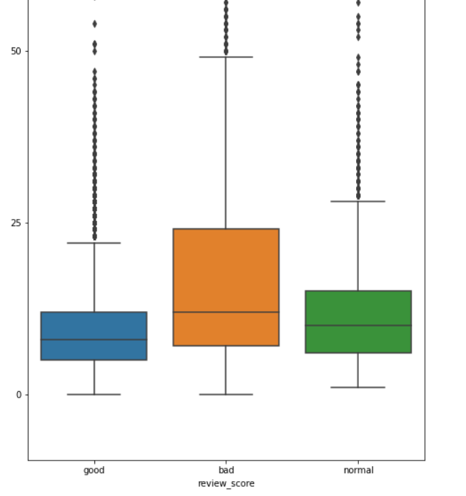
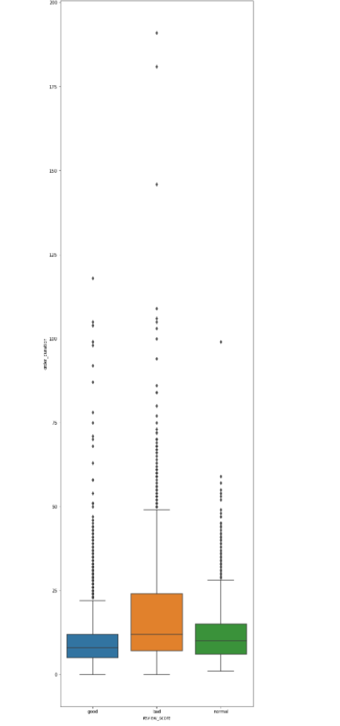
Rating vs Order duration

Slide 28
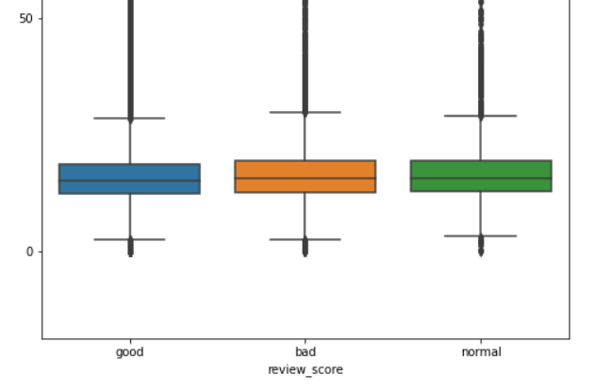
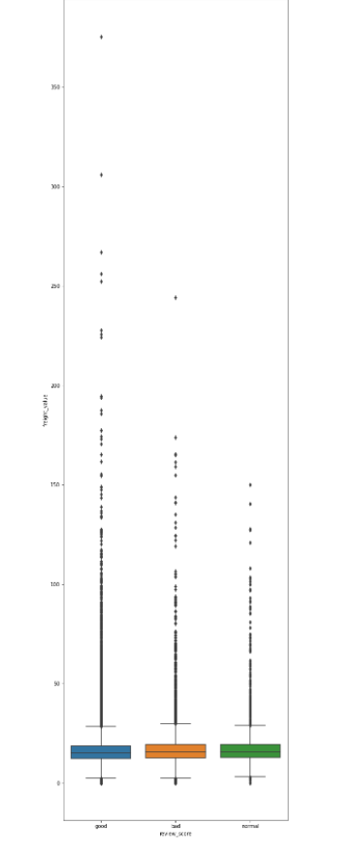
Rating vs Freight Value

Slide 29
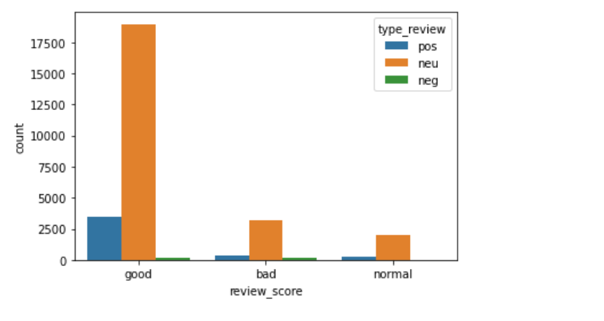
Rating vs Type of review

Slide 30
Rating vs Location

Slide 31
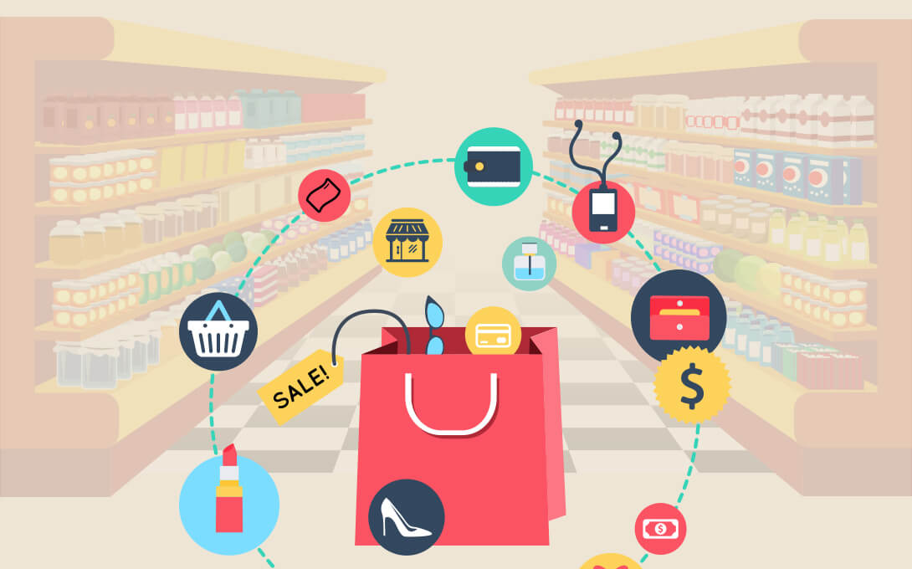
MARKET BASKET ANALYSIS
MBA is finding the association of different items with each other on the basis of how frequently they are bought.
It helps the marketeers to bundle the items or to plan a cross-sell to the customers.
Using apriori algorithm we figure out which items to be bought together.

Slide 32
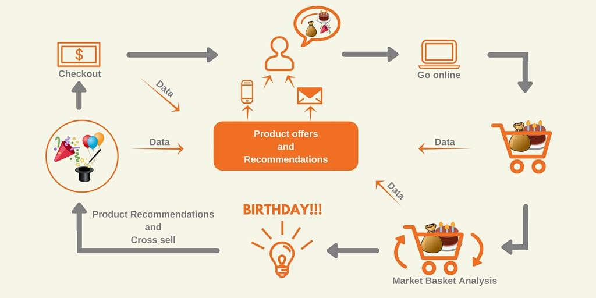

Slide 33
Inferences
We have here made a list of 476 item sets frequently bought together with a minimum support of 0.1%
since, the support is very less and data points are much, we got 176 association rules for each and every frequently bought item with each other showing us in turn
the average support as 0.5%
while the max support we got is 8.5%
minimum support was 0.2% from the frequent items sets we made, therefore we got so many rules(176) as the minimum support we chose was 0.1%, so that we cover all our bases and dont miss out on any item.

Slide 34

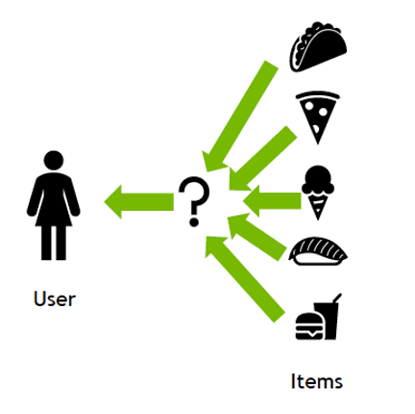
SCOPE
Further scope of this project for us is to implement a recommender system following the Market Basket Analysis on the products and segmenting customers on the basis of their loyalty(churn).

Slide 35

REFERENCES
www.kaggle.com/olistbr/brazilian-ecommerce
www.nairaproject.com
www.theconversation.com
www.papers.ssrn.com
https://www.kaggle.com/souravbarik/customer-satisfaction-using-olist-dataset#Understanding-the-data
https://github.com/ShrishailSGajbhar/PGPML-Projects/blob/master/Unsupervised%20Learning/Proj_UnsupPCA_SSG-2.ipynb

